Slide 1

Effect of stay-at-home order on Covid-19 infectious population growth rate
Analysis of France, Germany, UK, Italy, and Poland during October and November, 2020
STA 207 Project 3
Team 2: Zeng Fung Liew, Yixing Lu, Liela Meng, Apurv Srivastav

Slide 2

Introduction- Background Information
Due to interconnectedness of global economy the spread of COVID-19 has far surpassed that of the Influenza pandemic in 1918
Has led to over 115 million cases and 2.5 million deaths
Social Distancing measures were recommended by health professionals
Notes:
Apurv

Slide 3
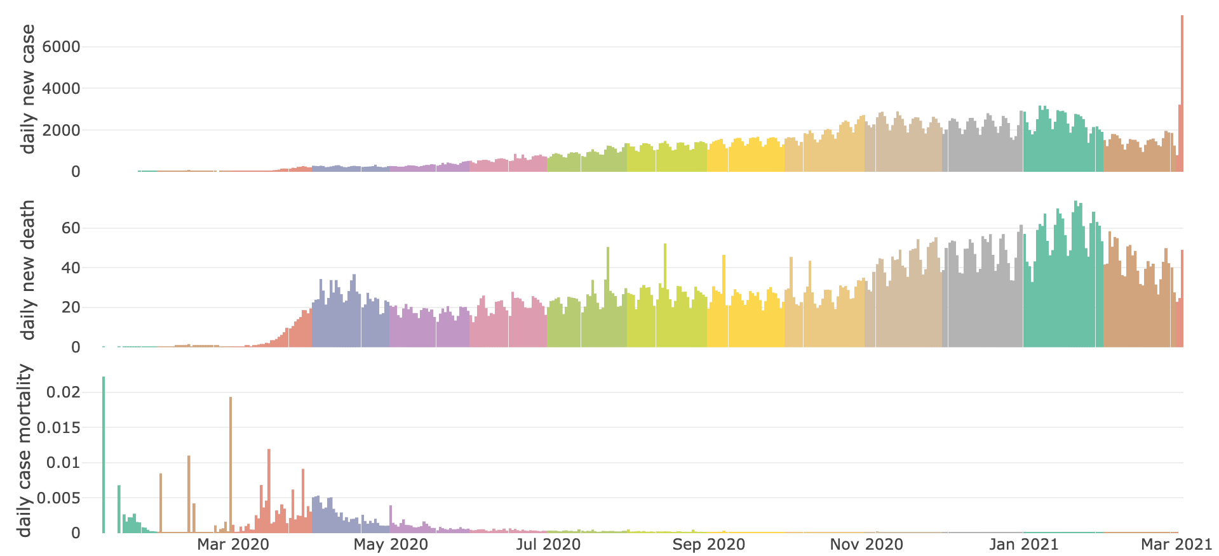

Figure 1: World average daily new case/new death/case mortality
Oct 1
Nov 30
Notes:
Apurv

Slide 4
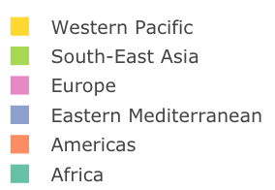
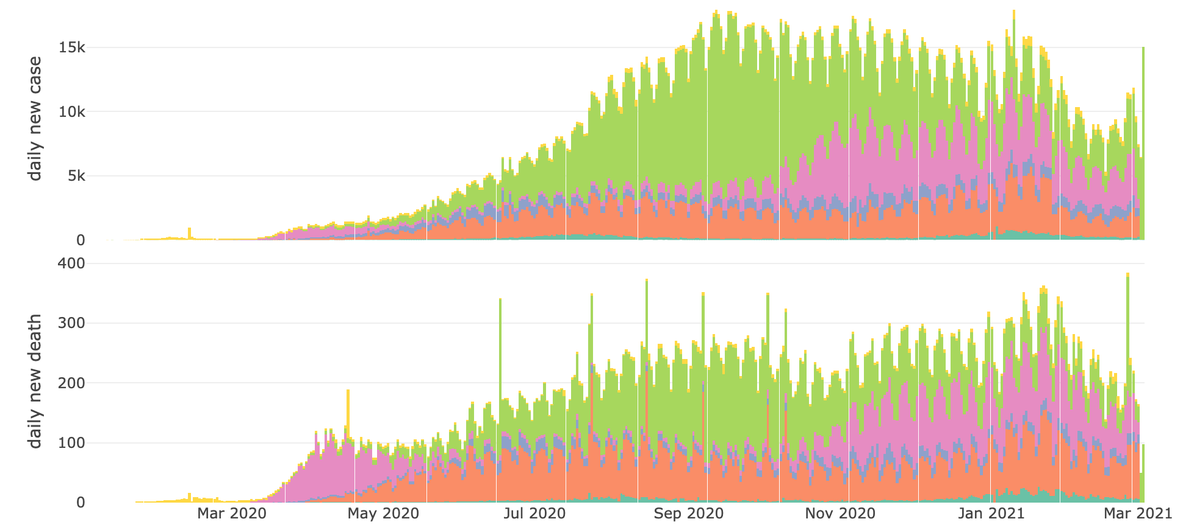
Figure 2: Average daily new/case death of each WHO Region
Oct 1
Nov 30
Notes:
Apurv: Why we choose the 5 countries

Slide 5
Introduction-Objectives
Two major objectives
  Find the lagged effect of stay-at-home order.
  Investigate the effect of strictness of stay-at-home order on growth rate of infectious population.
Notes:
Apurv

Slide 6
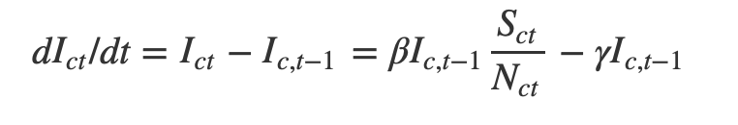

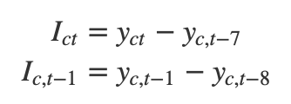
Response variable selection
SIR model for disease spread: N = I(t) + S(t) + R(t)
  N: population
  I: infectious
  S: susceptible
  R: Recovered
  β: rate of infection;
  𝛄: rate of recovery
  Assuming
Estimate infections population by
  Y: cumulative cases
Unknow
A measures of the spread of disease
Notes:
Yixing

Slide 7
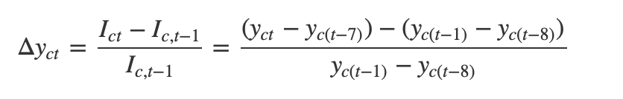
Response variable selection
Response variable: growth rate of infectious population
Notes:
Yixing

Slide 8
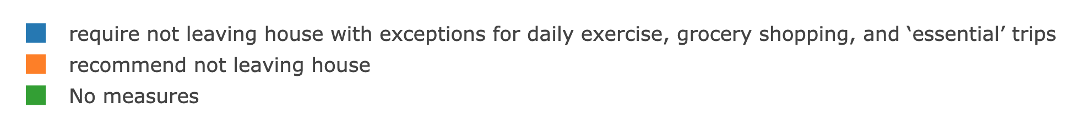
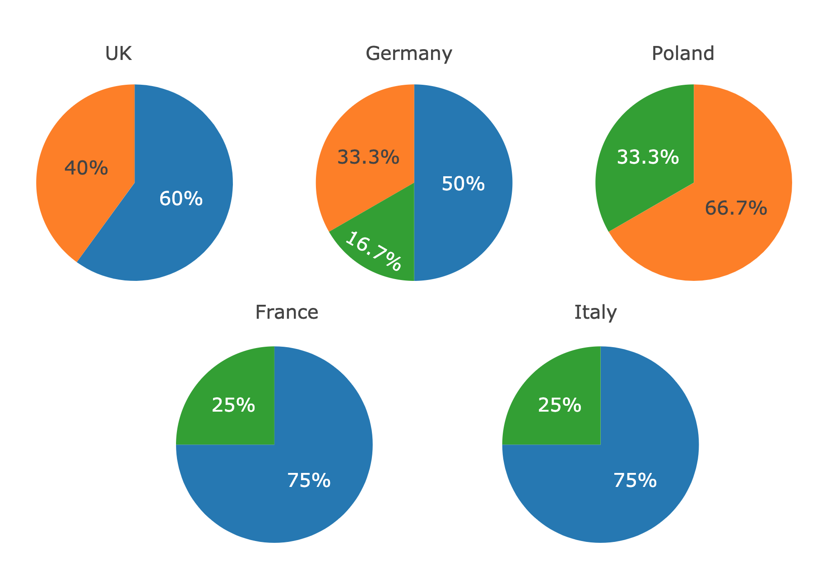
Predictor: strictness of stay-at-home requirements
Figure 3: Pie Chart of stay-at-home requirements
stricter
Notes:
Liela
At least one change per country

Slide 9

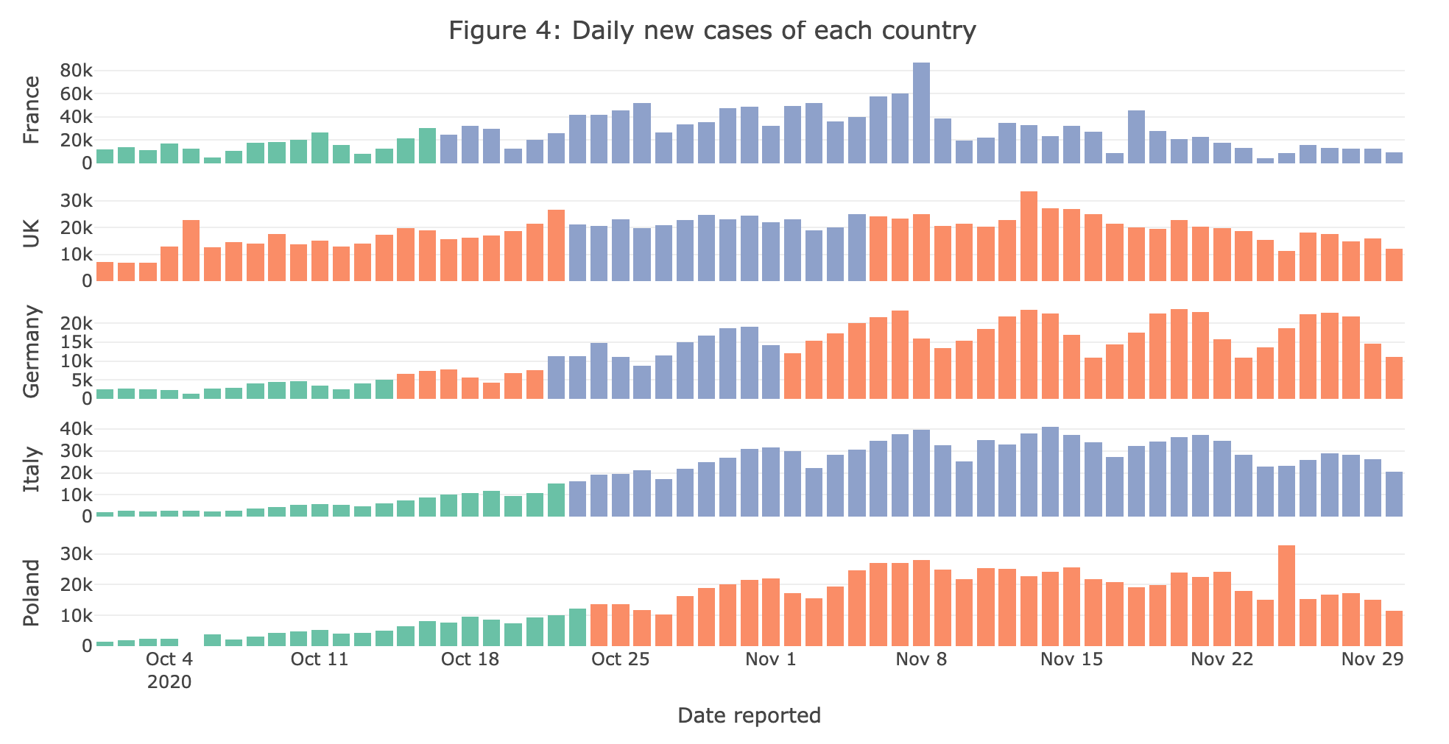
Figure 4: Daily new case of each country and stay-at-home order status
stricter
Mean daily new case by policy level:
15912 |  | 31077
15594 |  | 22130 | 20730
3240 | 6597 | 13833 | 17963
6211 |  | 29116
5423 |  | 20273
Notes:
Liela
No desc along with stricter restriction

Slide 10
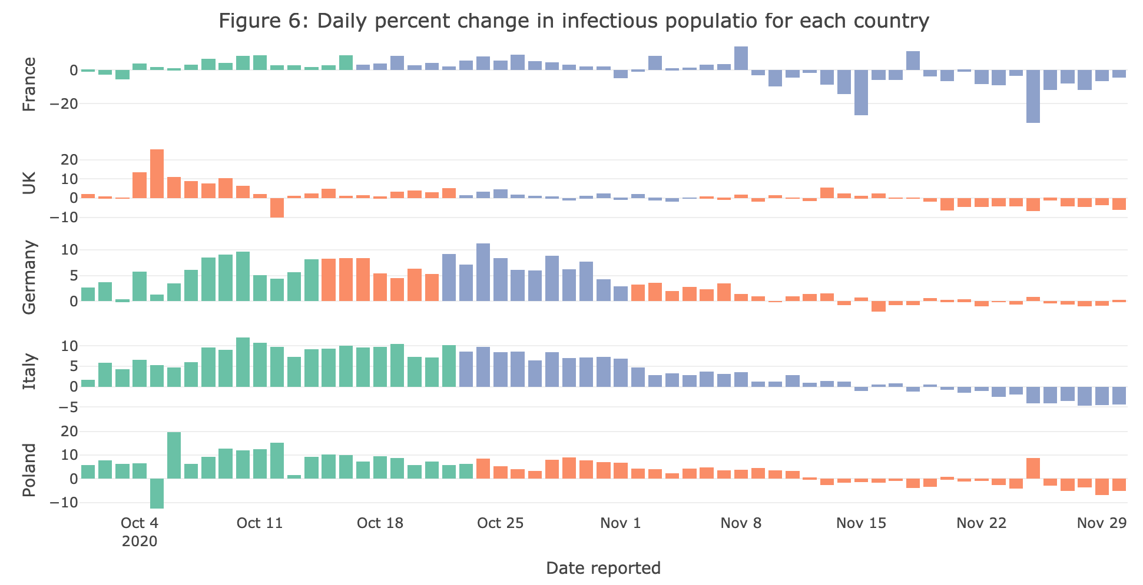
Figure 5: Daily percent change in infectious population for each country
Nov 12
Mean daily infectious rate by policy level:
3.13 |  | -1.65
4.86 |  | 1.07 | -1.66
5.26 | 6.65 | 7.07 | 0.62
8.02 |  | 2.02
7.94 |  | 1.59
Notes:
Liela
stricter restriction along with desc infectious rate negative

Slide 11
Inferential Analysis
Lagged effect of stay-at-home order
Effect of policy strictness on infectious population growth rate

Slide 12
Lagged effect of stay-at-home order
Model fitting
Model interpretation
Notes:
Yixing

Slide 13
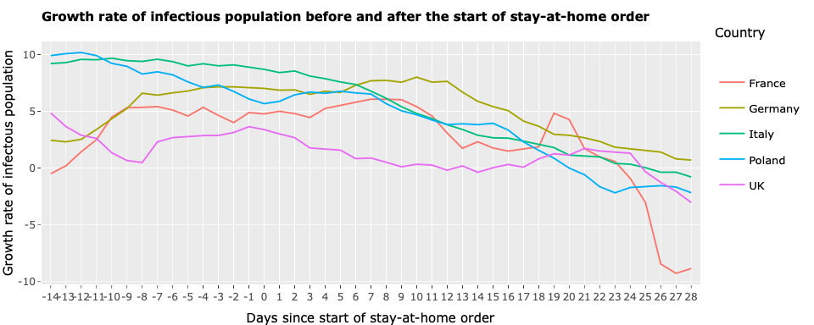
Notes:
Yixing

Slide 14
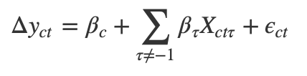
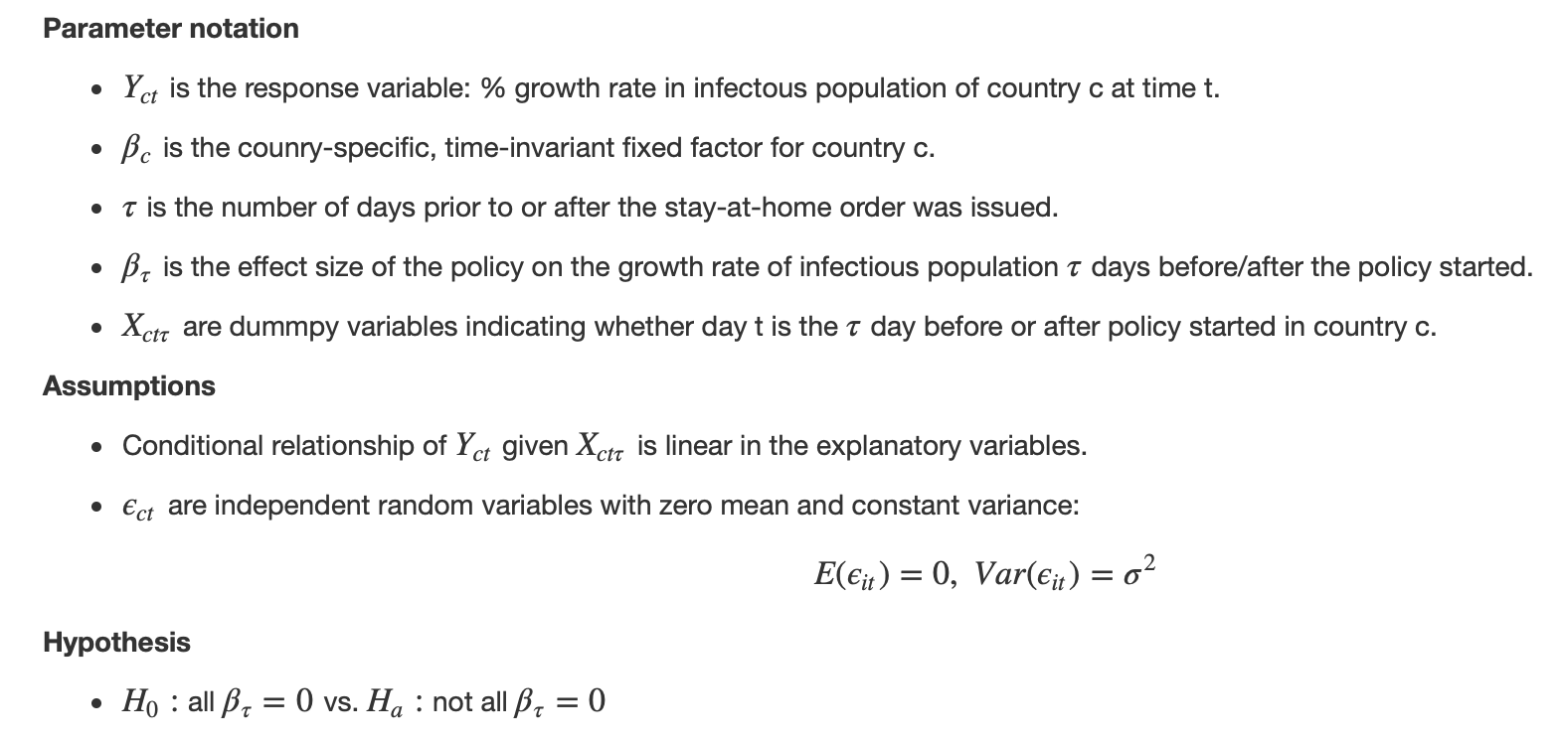
Model setup
Objective: measure the policy effect on growth rate of infectious population as a function of time since the order started.
Model:
Parameter notation:
Notes:
Yixing

Slide 15
Model setup
Assumptions
Hypothesis
  H0: β_{τ}=0 for 𝞽≠ -1 vs. Ha: β_{τ}≠0
Notes:
Yixing

Slide 16
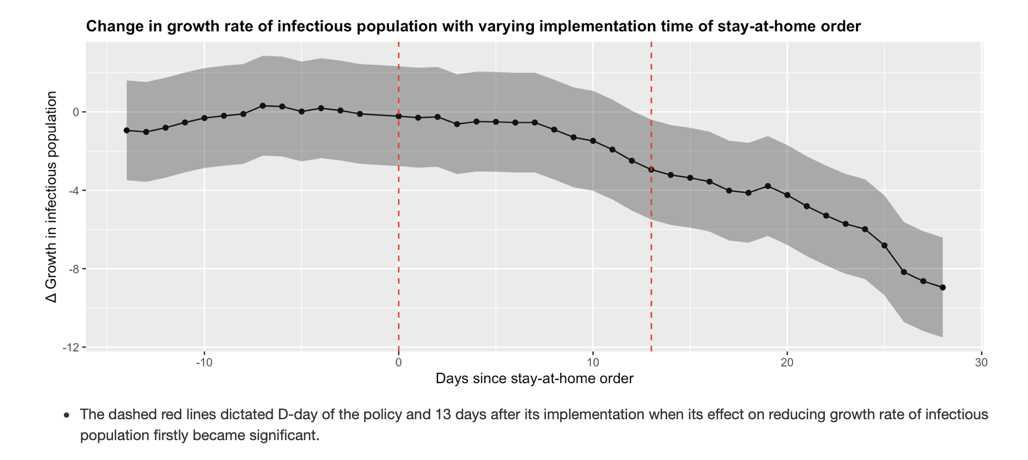
Model fitting results & interpretation
Significant effect start at Day 13 after implementation
Notes:
Yixing

Slide 17
Effect of policy strictness on infectious population growth rate
Model fitting
Model interpretation
Notes:
zengfung

Slide 18
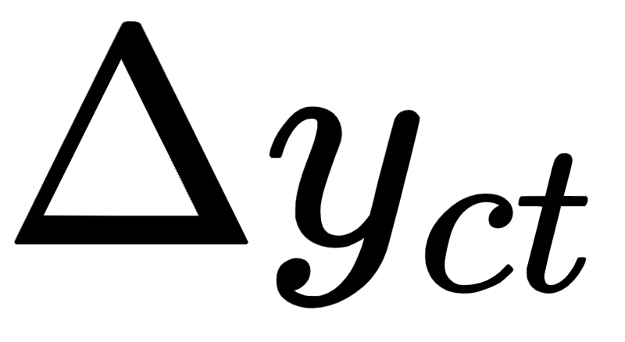


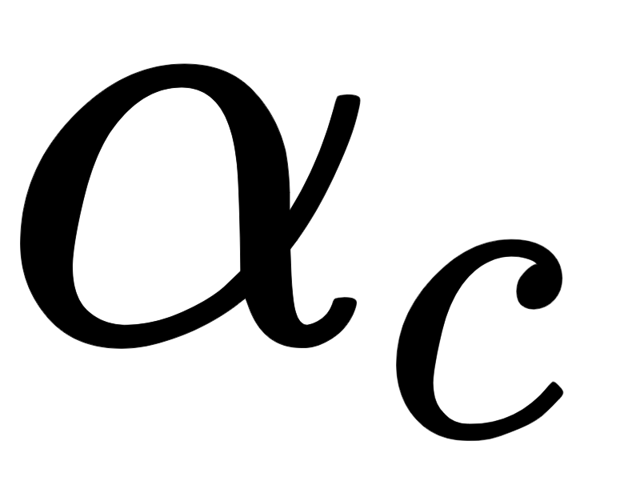
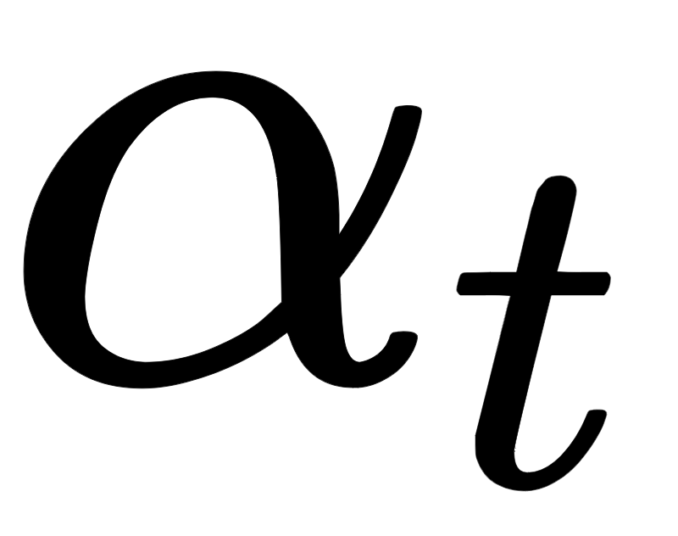
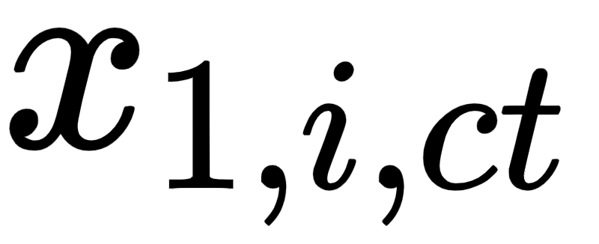

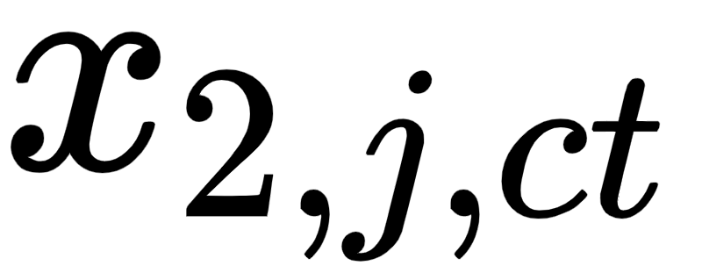

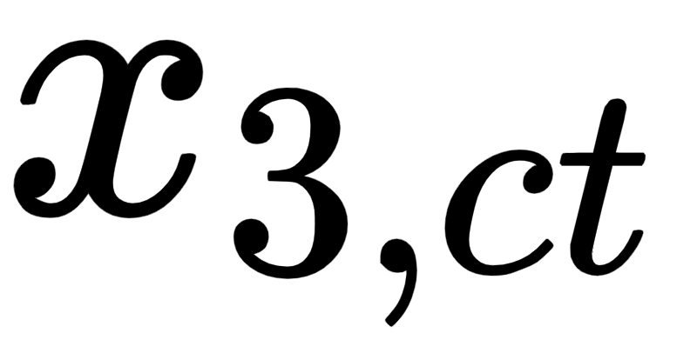
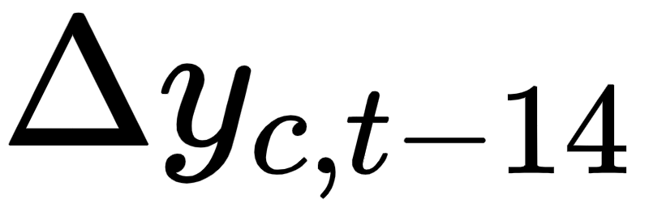
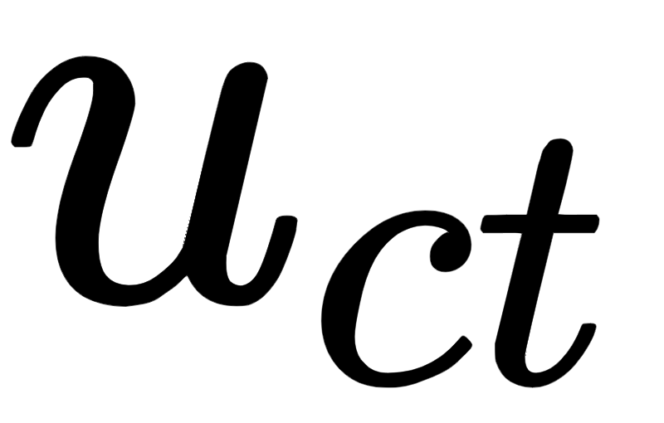
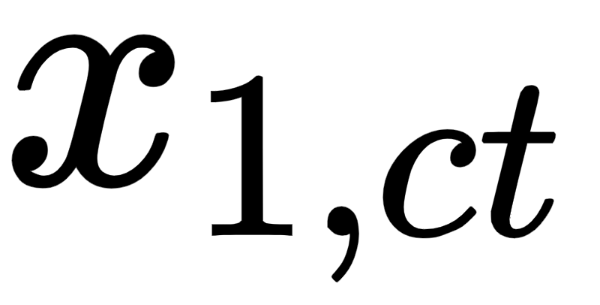
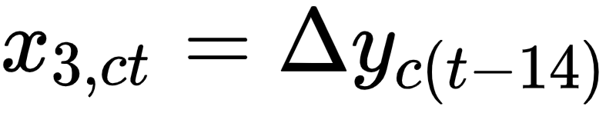
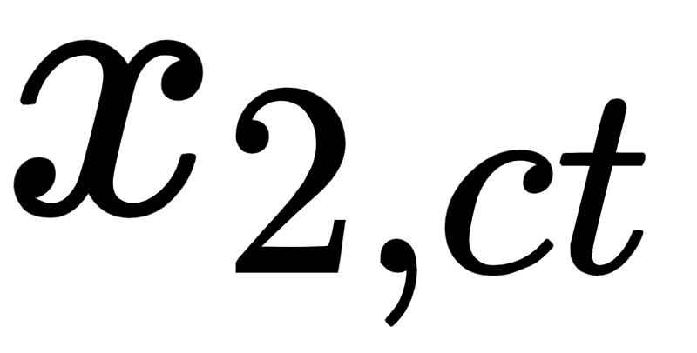
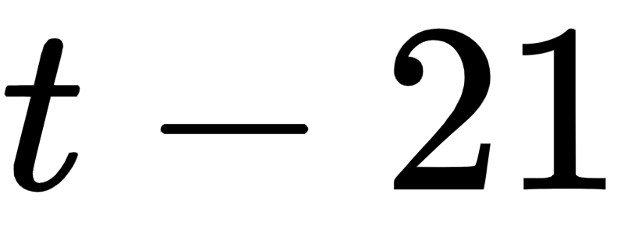
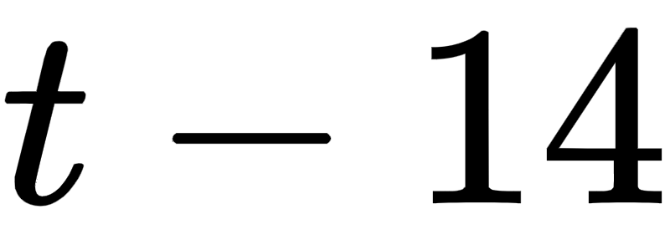
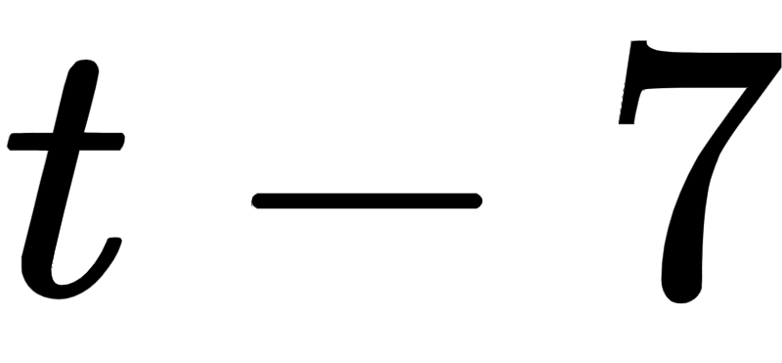
Model used
: 7-day moving average change in rate of active infections for country at time .
: Country-level fixed effect.
: Time-level fixed effect.
: Stay-at-home requirement level for country at time - 14 days , where = {0, 1, 2}
: 7-day change in stay-at-home requirement for country at time - 14 days, where = {-1, 0, 1, 2}
: The change in rate of active infections for country 14 days prior to time . This can be thought of as .
: Error for country at time .
Advantages:
Country-level fixed effect controls the time-invariant effect of countries which can impact the change in rate of active infections for each country, eg: weather, socioeconomic status, local health care systems etc.
Time-level fixed effect controls the factors that vary over time, eg: change in testing availability, national policies etc.
Notes:
Zf: make a line plot

Slide 19
Model fitting results
Coefficient estimates:
Country-level fixed effects coefficients:
Measurements on day t-14 | Estimate | Std. Error | t-value | p-value
Stay-home restriction = 1 | -6.26 | 0.45 | -14.03 | ≈0
Stay-home restriction = 2 | -8.43 | 0.43 | -19.48 | ≈0
Change in stay-home restriction = 0 | 2.95 | 0.73 | 4.03 | ≈0
Change in stay-home restriction = +1 | 4.72 | 0.87 | 5.44 | ≈0
Change in stay-home restriction = +2 | 7.32 | 1.08 | 6.75 | ≈0
Change in rate of active infections | 0.36 | 0.05 | 7.38 | ≈0
Country | France | Germany | Italy | Poland | UK
 | -0.08 | 2.82 | 2.343 | 1.09 | 4.22
Notes:
zf

Slide 20
Model Interpretation
Red: Estimated values as observed on graph
Black: Hypothetical values that did not exist on graph
Stay-at-home restriction level |  | Change in infectious population growth rate ( )
3 weeks ago | 2 weeks ago | France | Germany | Italy | Poland | UK
0 | 0 | 3.23 | 6.13 | 5.65 | 4.4 | 7.53
0 | 1 | -1.26 | 1.64 | 1.16 | -0.09 | 3.04
0 | 2 | -0.83 | 2.07 | 1.59 | 0.34 | 3.47
1 | 1 | -3.03 | -0.13 | -0.61 | -1.86 | 1.27
1 | 2 | -3.43 | -0.53 | -1.01 | -2.26 | 0.87
2 | 1 | -5.98 | -3.08 | -3.56 | -4.81 | -1.68
2 | 2 | -5.2 | -2.3 | -2.78 | -4.03 | -0.9
Notes:
Zf: write down that the values are the delta y

Slide 21
Sensitivity Analysis
Notes:
zf

Slide 22
Model Assumptions
All the predictor variables and error terms are identical and independently distributed (i.i.d) draws from their joint distribution.
  Did not hold. The predictor values for each country were not time invariant.
No perfect multicollinearity within predictor variables.
The error terms has conditional mean zero.
Homoscedasticity (constant variance) of the response variable.
Influential outliers do not exist.
Notes:
zf

Slide 23
Additional Tests
Test for fixed-effects vs random-effects (Hausman-Durbin-Wu test)
  Random-effects model is a better fit
  However, a random-effects model on fixed-entities like countries did not make sense.
Test for cross-sectional dependence (Breusch-Pagan LM test)
  Cross-sectional dependence exists in our model
  Predictors are not entirely independent, which can lead to Type-1 error inflation.
Notes:
zf

Slide 24
Causal Interpretation-Assumptions
Variables that were accounted for
  Similar region
  Populations and population entities were not completely different between the countries
  Racial Demographic is similar among all 5 countries
  Same time frame accounts for similar weather among variables
  Age demographic (median ages for all countries were similar)
Variables not accounted for
  Other mandates issued (differed from country to country)

Slide 25
Causal Interpretation-Propensity Score
Variables selected
  14-day lagged effect of stay-at-home order
  14-day lagged effect of change in stay-at-home order
  14-day lagged effect of change in rate of active infections
Variable used for propensity score
  14-day lagged effect of stay-at-home order
    not binomial so a Generalized Boosted Model was used to develop propensity scores
Notes:
Apurv

Slide 26
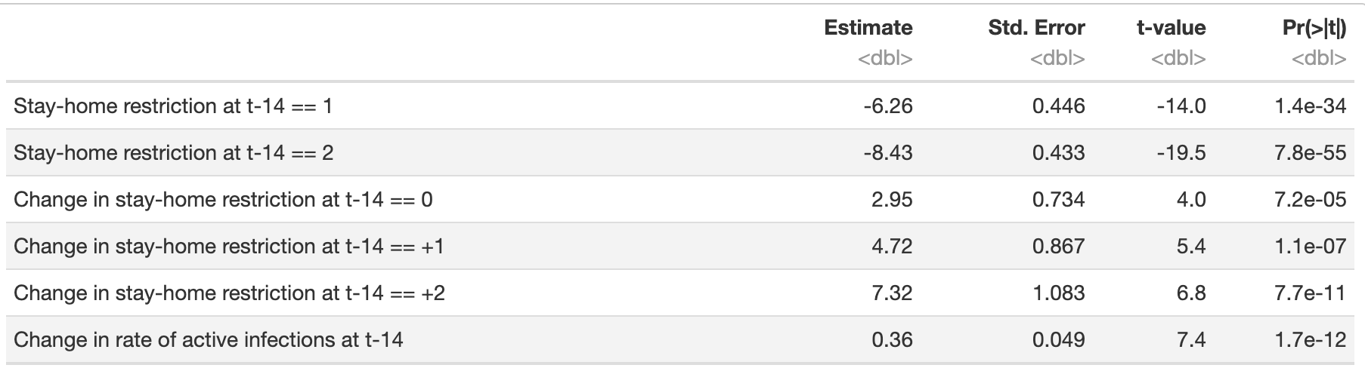
Causal Interpretation- Weighted Model
Original Model
Notes:
Apurv

Slide 27
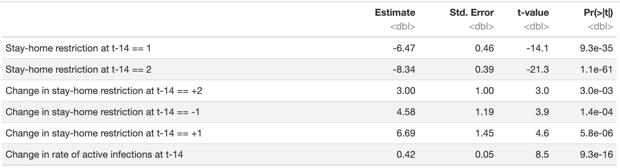
Causal Interpretation- Weighted Model
Weighted Model
Notes:
Apurv

Slide 28
Discussion- Findings of Inferential Analysis
From the fixed effects model, the both positive and negative associations were found
Causal Interpretation allows us to conclude that these variables had an effect on 7-day moving average change in rate of active infections
Notes:
Apurv

Slide 29
Discussion- Caveats of Current Analysis
Data only taken from October 1st to November 30th
Only 5 countries from Europe were selected
Breusch-Pagan LM test showed that cross-sectional dependence exists within the model
Notes:
Apurv

Slide 30
Discussion-Suggestions for Future Research
Selection of more representative sample from around the world as well as running the analysis for a longer time-period to account for changing seasons
Future Research should account for confounder variables that have all been associated with COVID-19
Can branch to include other policies
Notes:
Apurv

Slide 31
References
[1] Fowler, J., Hill, S., Levin, R., Obradovich, N..(2020) The Effect of Stay-at-Home Orders on COVID-19 Infections on the United States. [medrxiv.org](https://www.medrxiv.org/content/10.1101/2020.04.13.20063628v2.full)
[2] Torres-Reyna, O. (2010) Getting Started in Fixed/Random Effects Models using R. Lecture slides. [dss.princeton.edu](https://dss.princeton.edu/training/Panel101R.pdf)
[3] Schmidheiny, K. (2020) Panel Data: Fixed and Random Effects. Lecture Notes. [schmidheiny.name](https://www.schmidheiny.name/teaching/panel2up.pdf)
[4] Thomas Hale, Sam Webster, Anna Petherick, Toby Phillips, and Beatriz Kira (2020). Oxford COVID-19 Government Response Tracker, Blavatnik School of Government.
[5] Fowler, J. H., Hill, S. J., Levin, R., & Obradovich, N. (2020). The effect of stay-at-home orders on COVID-19 infections in the United States. arXiv preprint arXiv:2004.06098.
[6] European countries by Population (2021). (n.d.). Retrieved March 05, 2021, from https://www.worldometers.info/population/countries-in-europe-by-population/
[7] CDC (11 February 2020). "Coronavirus Disease 2019 (COVID-19)". Centers for Disease Control and Prevention. Retrieved 6 December 2020.
[8] Gandhi RT, Lynch JB, Del Rio C (April 2020). "Mild or Moderate Covid-19". The New England Journal of Medicine. 383 (18): 1757–1766. doi:10.1056/NEJMcp2009249. PMID 32329974
[9] Ritchie, R. (n.d.). Covid-19: Stay-at-home restrictions. Retrieved March 05, 2021, from https://ourworldindata.org/covid-stay-home-restrictions
[10] Ethnicity and race by countries. (n.d.). Retrieved March 05, 2021, from https://www.infoplease.com/world/social-statistics/ethnicity-and-race-countries
[11] Risk for Covid-19 infection, hospitalization, and death by race/ethnicity. (n.d.). Retrieved March 05, 2021, from https://www.cdc.gov/coronavirus/2019-ncov/covid-data/investigations-discovery/hospitalization-death-by-race-ethnicity.html
[12] Olmos, A., & Govindasamy, P. (2015). A Practical Guide for Using Propensity Score Weighting in R. Practical Assessment, Research & Evaluation, 20(13). Available online: http://pareonline.net/getvn.asp?v=20&n=13

